Slide 1
Data Analytics Portfolio
By Aarthi Subramanian

Slide 2














Contents
01 Game Co
Regional Sales Analysis
02 Tackling Influenza
US Epidemic Analysis and forecast
03 Rockbuster Stealth
Inventory Analytics
04 Instacart Basket
Operational and Marketing Analytics
05 PE Bank
Predictive Analytics on customer retention

Slide 3

Business Case
An international videogame company wants insights on its sales regional development. Specifically, what types of genres are more popular in certain regions and which market trends are shaping the market.
Data
Game Co sales dataset from North-America (NA), Europe (EU) and Japan (JP) and other regions.
Timeframe: 1980 to 2016
Tools used:
Game Co
General Procedure and Analysis
Comprehensive Data Cleaning
Descriptive Analysis with Pivot Tables and Visualizations
EDA and Forecasting

Slide 4
Time Analysis
Regional Market shares - Forecast
2010
2011
2012
NA
2013
EU
2014
JP
2015
Other
2016
2017
North America sales are in peak of 93% at 1983 have more fluctuations upto 2010 and then gradually decreasing by years and clustered towards Lower values.
Europe Region sales gradually increasing from 6% at 1980 to 38 % by 2016 and trends are growth by years.
Japan Region sales have more fluctuations and reached peak of 55% at 1993 and then gradually decreasing and increasing after 2013.
Other Region sales overall are less than 13 % and trends are increasing by years.
Regional market share (1980 - 2016)
Region | Development | Actual stand
NA | -19% | 31%
EU | 8% | 37%
JP | 9% | 19%
Other | 2% | 12%

Slide 5
Genre Distribution
NA Sales distribution according to genre
(2010-2016)
TOP 3 Genres in EU (2010-2016)
100%
90%
Sports 14%
Action Shooter Sports Misc
Role-Playing
Platform
80%
Shooter 20%
Misc 11%
70%
60%
50%
Role-Playing 10%
40%
Racing
30%
Fighting
20%
Action
26%
Simulation
10%
Adventure
0%
2010
2011
2012
2013
2014
2015
2016
Strategy
Action
Shooter
Sports
Other
Action, Shooter and Sports are the top 3 genres in EU
Their combined market share was 50% and now is 80%
Sports has increased and expected to be the top genre
Action, Shooter and Sports are the top 3 genres in NA
These 3 genres make up more than 50% of all sales

Slide 6
Conclusion
Increase the marketing budget allocation, refine targeting strategies for Europe and Other regions to reach more audience.
Check for any New Competitors or Technology trends or Gaming Trends or Economic factor or Gaming Regulations in North America why sales have more fluctuations and decreasing from 93% to 32% by years.
As Japan is small demographic region , so increase the marketing budget allocation and find trends(Aging , Any new Technology , Globalization of Gaming market , Gaming preferences , Culture shifts) which affecting Japan sales after 1996.
Game Co should focus its efforts in dominating the sales for Action, Shooter and Sports
More specifically, Game Co should focus on the sports genre since it is prognosed to be the top genre

Slide 7



Business Case
Tableau link
A medical staffing agency in the United States needs to understand the epidemiological behavior of influenza in order to send the medical staff accordingly for the next season.
Understand: Who is at risk? Where are these groups located? When do influenza deaths peak?
Create a forecast to prepare for the next season
Data
“Influenza deaths by geography” – CDC (2009-2017)
“Population data census” – US Census Bureau (2009-2017)
Tools used:
Tackling Influenza
General Procedure and Analysis
Comprehensive Data Cleaning
Descriptive Analysis and Hypothesis Testing in Excel
EDA and Visualization in Tableau
8

Slide 8
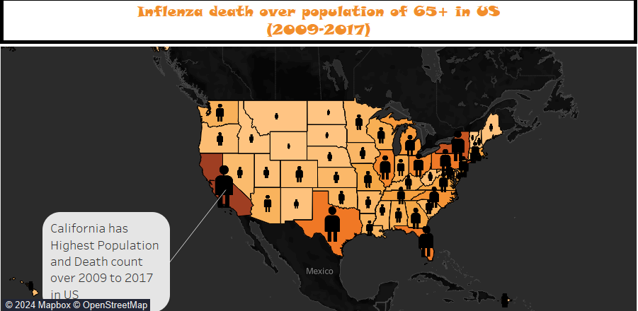
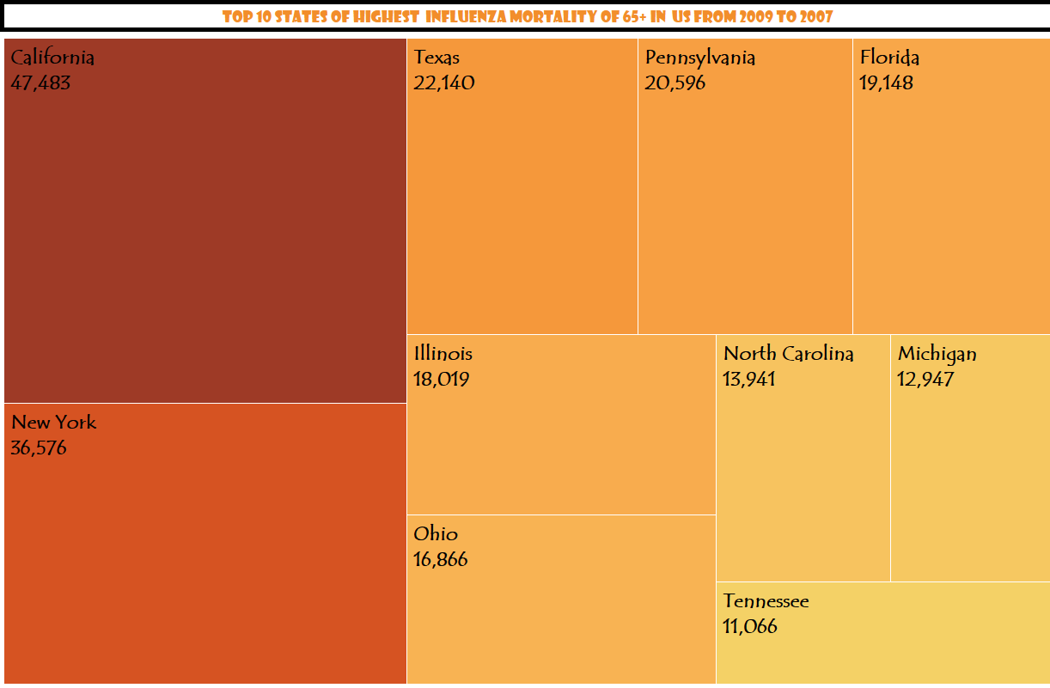
Population is lowest in Vermont state.
Death is lowest in Alaska , North Dakota , Wyoming, District of Columbia , Delaware , Vermont , Puerto Rico states.
Population and death is highest in California state.
Top 10 states of highest mortality of 65+ are California , NewYork , Texas , Pennsylvania , Ilinois , North Carolina , Michigan , FLorida , Ohio , Tennessee. Based on this analysis we can allocate more staffs to these states.

Slide 9
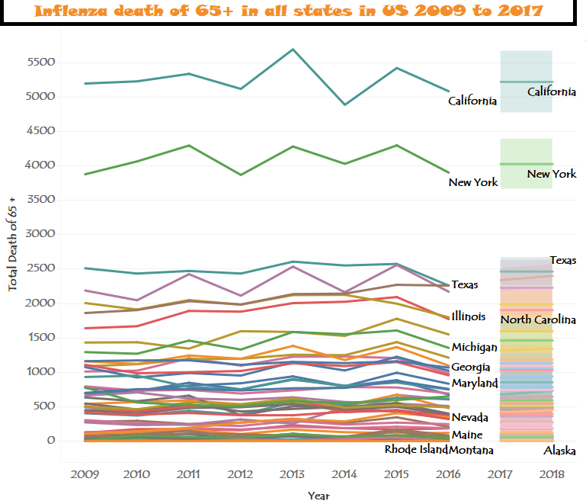
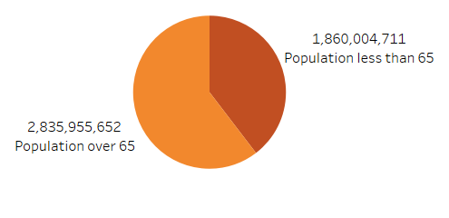
This Forecasting for 2018 year for all states so based on this and top influenza mortality rates staffs can be allocated to those states. This is for population over 65 and less than 65 age.

Slide 10
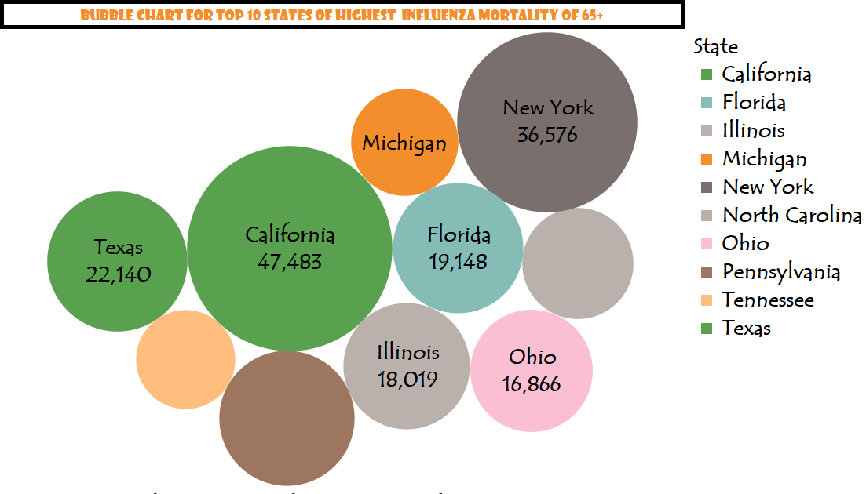
Conclusion
Based on analysis of Total population and death of 65+ age people, here we can allocate staffs to states listed in bubble chart which has more death by future forecasting for 2018 year.
So Focus the staffing agency efforts into these top states, specifically, California, New York and Texas.

Slide 11


Business Case
Tableau Story
Git Hub Link
A movie rental company is planning to use its existing movie licenses to launch an online video store in 2020
Understand: inventory analysis, customer analysis, regional analysis
Data
Rockbuster Stealth’s Relational Database (15 tables)
Tools used:
Rockbuster Stealth
General Procedure and Analysis
Created an ERD and a Data Dictionary
In PgAdmin 4, applied joins, subqueries and CTEs to extract the information required by stakeholders.
EDA through querying
Created supporting visualizations with Tableau

Slide 12
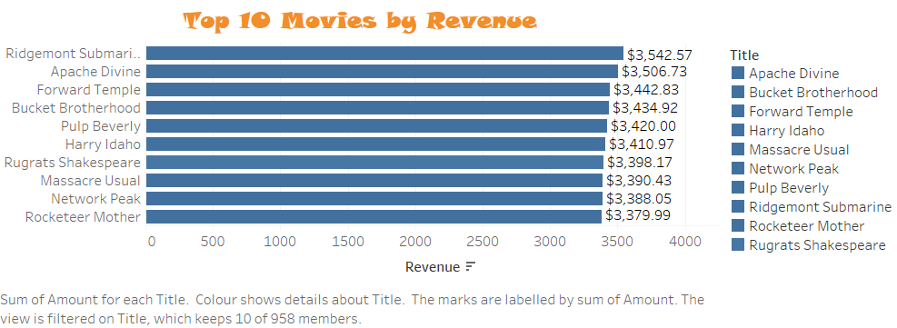
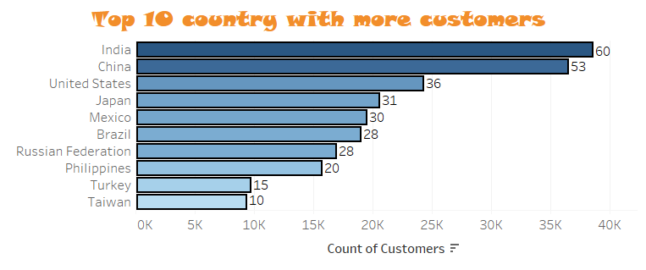
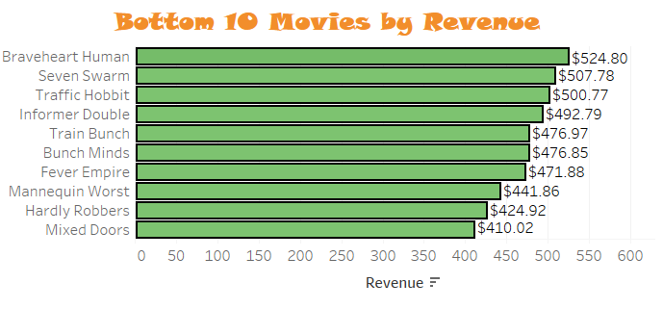
Listing Top 10 and Bottom 10 Movies based on Revenue in dollars. Top Revenue spent is 3,542.57 dollars and Least Revenue spent is 410.02 dollars
Here listing Top 10 countries with more customers , in this India is in Top which holds more customers.

Slide 13
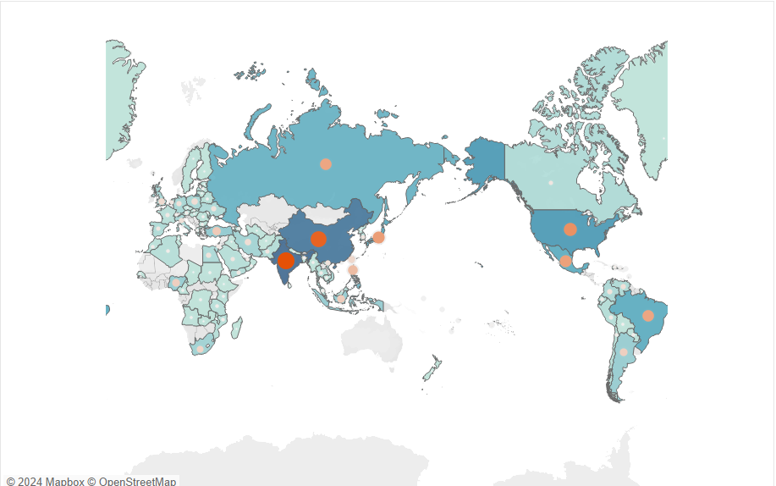
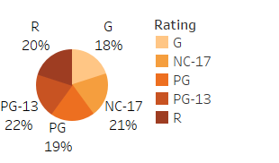
Top 3 countries with more Customers:
India
China
USA
Top 3 ratings:
PG-13
NC-17
R

Slide 14
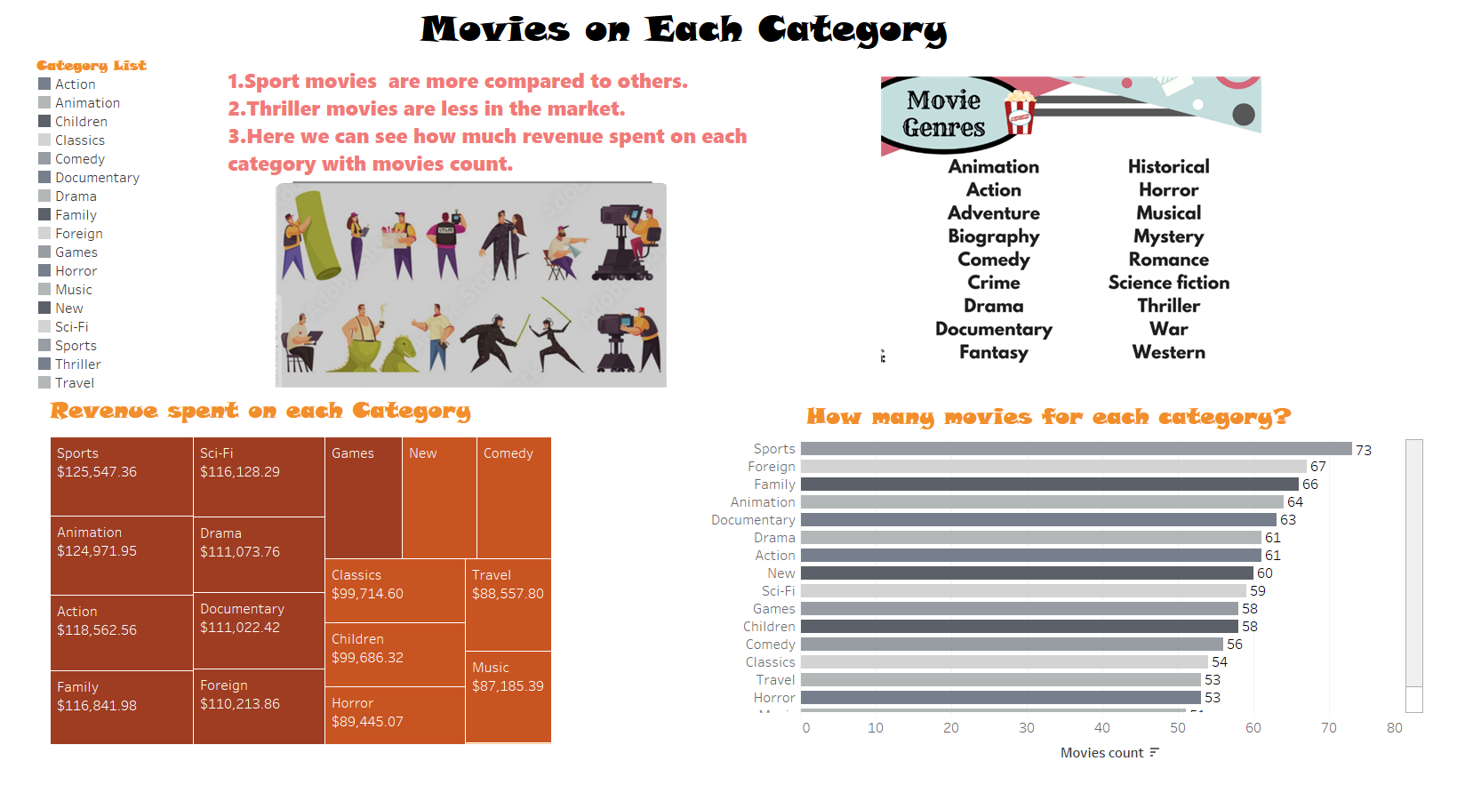

Slide 15

Conclusion
The Top most Genre is Sports
The Top most Country with More Customers is India
The Most frequently used Rating is PG -13
Rockbuster Stealth should focus its efforts into advertising this new platform in the top 10 countries and prioritizing customers from said countries.
Contact all customers and inform them of the new platform

Slide 16


Git Hub Link
Business Case
Instacart, an online retailer, plans to apply targeted marketing to its customers. In order to do so, it is essential to understand its customer base
Understand: customer demographics, customer profiling, shopping times, shopping behavior
Data
“The Instacart Online Grocery Shopping Dataset 2017”
32,404,859 rows/entries
Tools used:
Instacart Basket
General Procedure and Analysis
Data cleaning, data merging and EDA using Pandas and NumPy
Data visualization with Seaborn and Matplolib
Compiled documentation, insights and analysis on an Excel report

Slide 17
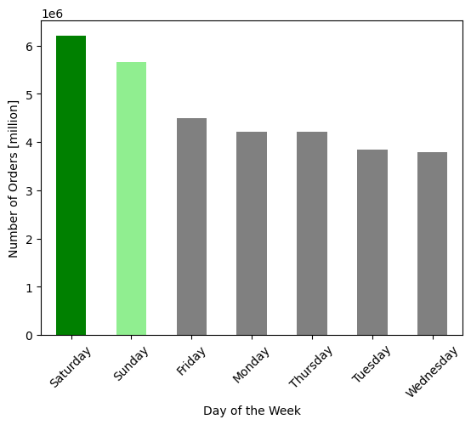
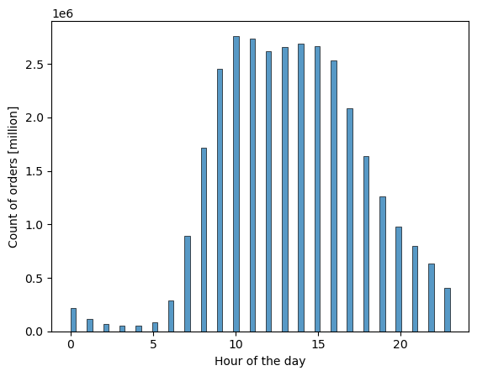
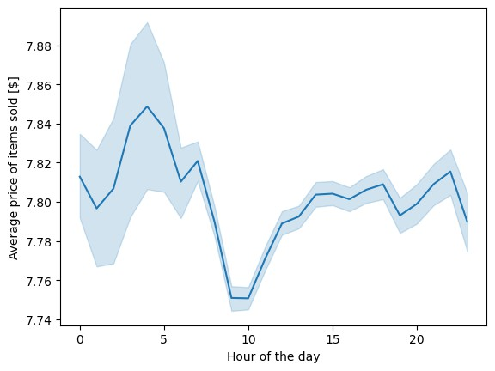
Type of order
Saturday and Sunday are the days with most orders
Most of the orders happen between 10am and 16pm
The orders with the highest average price of items occur between midnight and 6am
Specifically between 3am and 4am

Slide 18
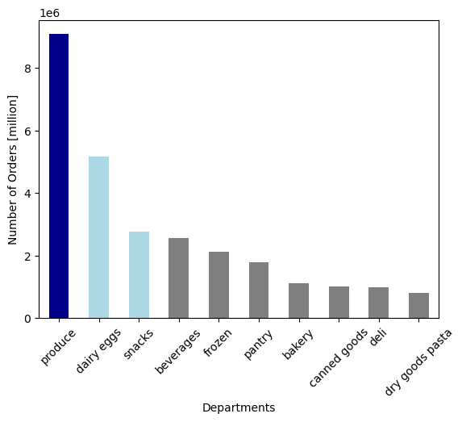
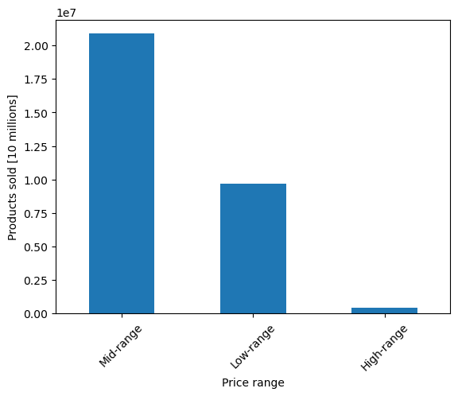
Frequency and loyalty
Produce, dairy and snacks are the most popular departments
These are the top 10 departments from 21 departments
67.47% items sold were in the mid-range price $5 to $15
Only 1.29% of products are low-range. Price is less than $5

Slide 19
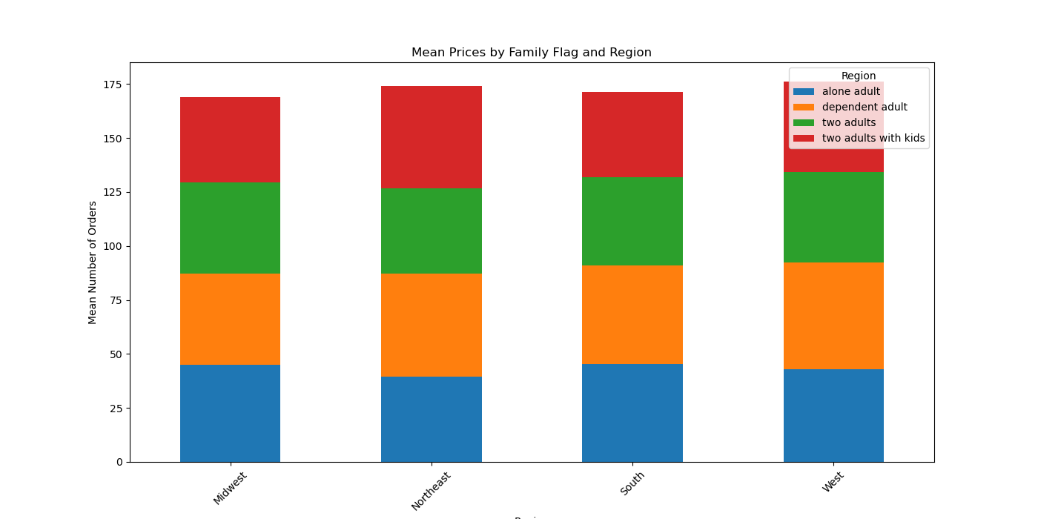
Across Regions
All orders remain same across Midwest , Northeast , South , West regions.

Slide 20
Conclusion
Instacart should target ads for high priced items between 12 and 6am
Server maintenance should not happen at high ordering times such as Saturday and Sunday or between 10 am and 16 pm
The company has mostly 'Regular customers', but there is a big portion of 'Loyal customers'.
Nor age, neither family status doesn't influence the ordering habits.

Slide 21

Excel Project
Business Case
A bank needs a preliminary classification model that will predict whether a customer will churn or not
Understand: customer analytics
Data
PE Bank data
Tools used:
General Procedure and Analysis
Comprehensive data cleaning
Descriptive statistics, EDA and Pivot Tables to fully understand the
data
Create a decision tree based on differences found between both customer types: Customers who left and current customers.
PE Bank
24

Slide 22
Comparing Descriptive Statistics
Customers who left
 | MIN | MAX | AVERAGE
Credit Score | 376.00 | 850.00 | 637.14
Age | 22.00 | 69.00 | 45.19
Tenure | 0.00 | 10.00 | 4.70
Balance | 0.00 | 213146.20 | 90476.45
Number of Products | 1.00 | 4.00 | 1.47
Estimated Salary | 417.41 | 199725.39 | 97196.54
Current Customers
 | MIN | MAX | AVERAGE
Credit Score | 411.00 | 850.00 | 651.83
Age | 18.00 | 82.00 | 37.39
Tenure | 0.00 | 10.00 | 5.16
Balance | 0.00 | 197041.80 | 74836.45
Number of Products | 1.00 | 3.00 | 1.54
Estimated Salary | 371.05 | 199661.50 | 98977.65
The average credit score of customers who left is 14 points lower than the customers who stayer.
Their average balance of the customers who left is higher than the customers that stayed. Meaning that with a higher balance they may have found better alternatives from other banks.
The descriptive statistics of numerical attributes for both customer groups are very similar
The most notable difference lies in the maximum age.
There is a 13 year difference between both maximum ages
25

Slide 23
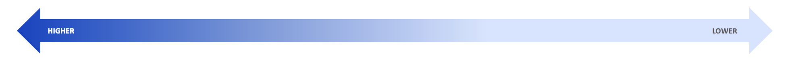
Decision Tree
Will the customer leave the bank?
INACTIVE MEMBER
Yes
No
1 PRODUCT
1 PRODUCT
Yes
No
Yes
No
HAS CREDIT CARD
ACTIVE MEMBER
HAS CREDIT CARD
ACTIVE MEMBER
Yes
No
Yes
No
Yes
No
Yes
No
POOR/FAIR CREDIT SCORE
POOR/FAIR CREDIT SCORE
POOR/FAIR CREDIT SCORE
POOR/FAIR CREDIT SCORE
POOR/FAIR CREDIT SCORE
POOR/FAIR CREDIT SCORE
POOR/FAIR CREDIT SCORE
POOR/FAIR CREDIT SCORE
Yes
No
Yes
No
Yes
No
Yes
No
Yes
No
Yes
No
Yes
No
Yes
No
FEMALE
FEMALE
FEMALE
FEMALE
FEMALE
FEMALE
FEMALE
FEMALE
FEMALE
FEMALE
FEMALE
FEMALE
FEMALE
FEMALE
FEMALE
FEMALE
26

Slide 24
Conclusion
This model should be deployed and its results should be monitored in order to further improve its reliability
Activity Incentives: Introduce a reward program that encourages account activity
Reach out to these customers with personalized messages and offers. This can include personalized financial advice, invitations to exclusive events, or updates on new products and services tailored to their needsThe characteristics at the top are the have the highest impact, where as the ones lower will have less impact.

Slide 25

Tableau Link
Business Case
Covid-20 death rate with conditions contributing to death by state wise.
Understand: Patients demographics, customer profiling, shopping times, shopping behaviour.
Data
This data shows Conditions Contributing to COVID-19 Deaths, by State and Age, Provisional 2020-2023
Tools used:
General Procedure and Analysis
Data cleaning, data merging and EDA using Pandas and NumPy
Data visualization with Seaborn and Matplolib
Compiled documentation, insights and analysis on an Excel report

Slide 26
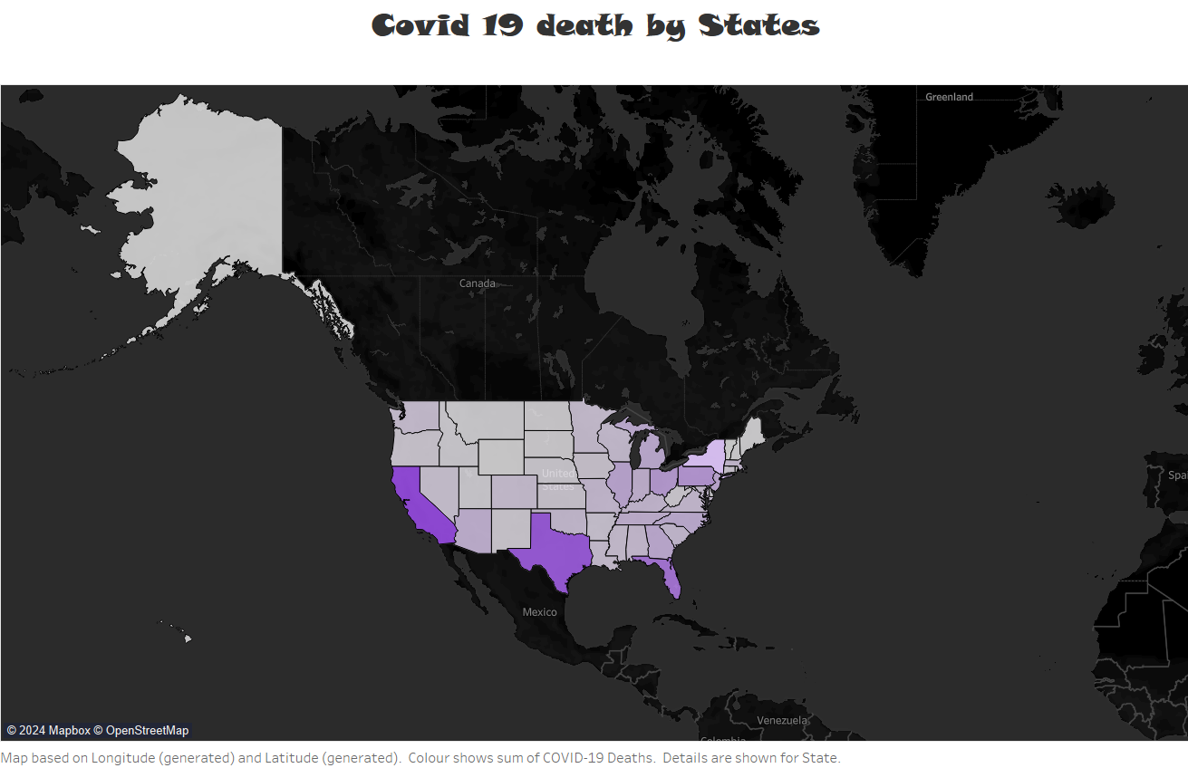
Geographic views
Top 3 States has more deaths:
California
Texas
Florida

Slide 27

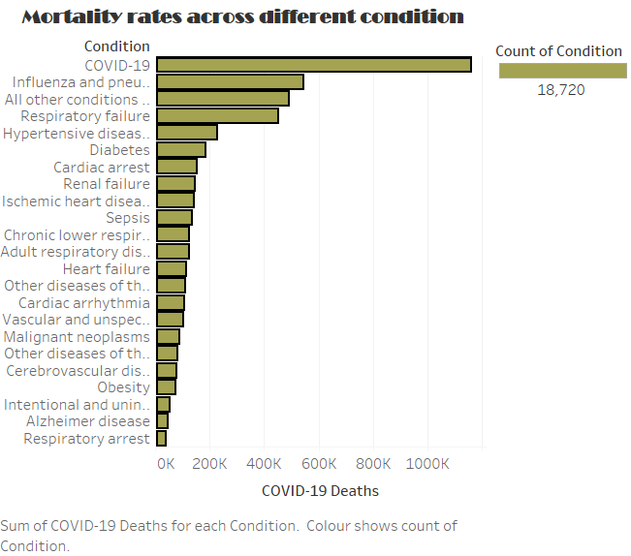
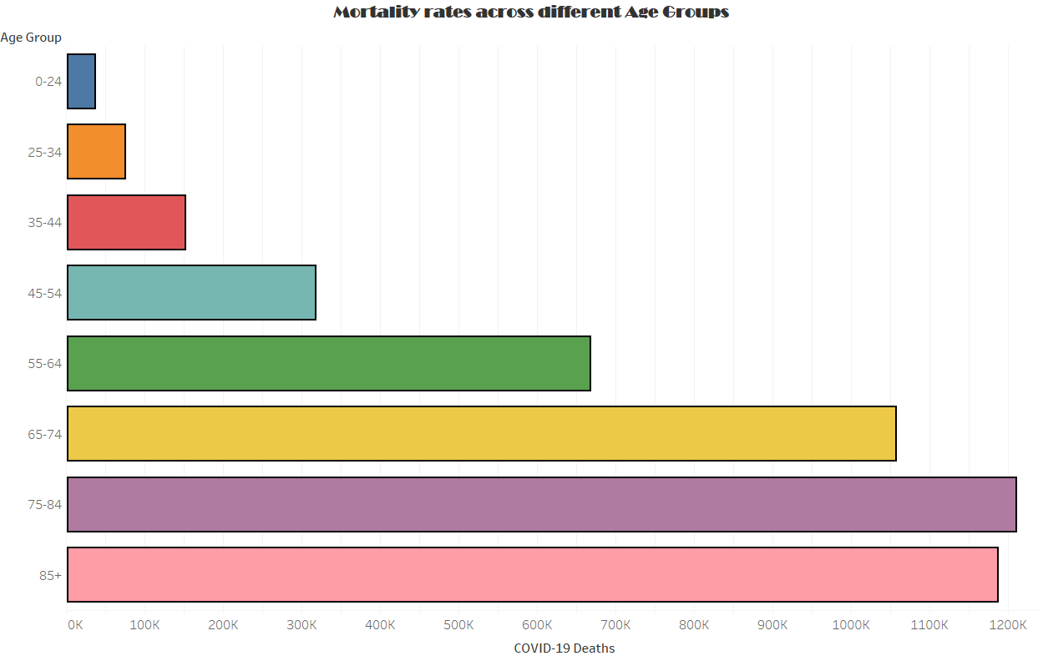
Mortality Rates
Top 3 Conditions contributing to death:
COVID-19
Influenza and pneumonia
All other conditions and causes (residual)
Mortality rates increases by ages.
As Age increases death rates also increases.
This both has good correlation.

Slide 28
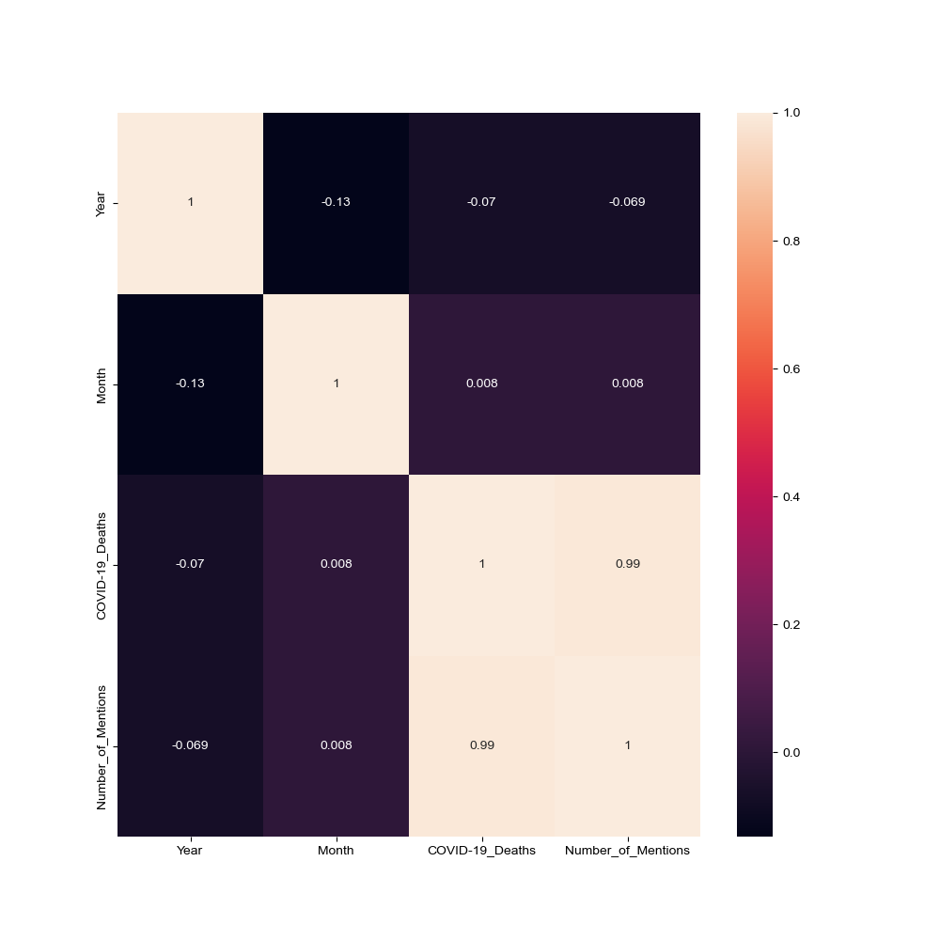
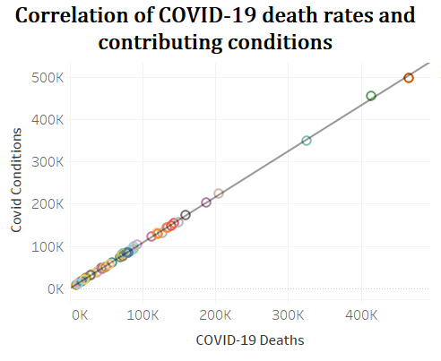
Correlations
As condition contributing to death increases then death rate increases is shows in scatterplot above, this shows strong correlations.

Slide 29
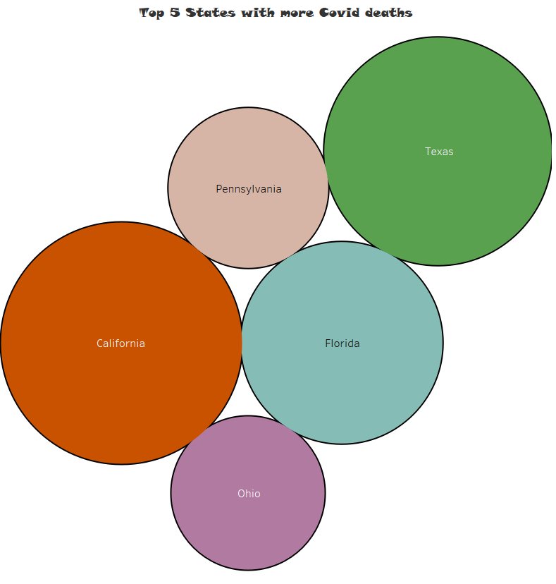

Conclusion
Condition causing covid increases then covid death increases.
Age increases then covid death also increases

Slide 30



Thank you
Contact me

